Slide 1
Introduction to machine learning
Introduction
R. Brooks

Slide 2
Why Machine Learning?

Slide 3
Who?
Responsible: Richard Brooks rib@via.dk
Instructors: Ole Ildsgaard Hougaard oih@via.dk

Slide 4
Prerequisites*
Basic computer science principles
Big-O notation, data structures and general sense of algorithmic thinking
Comfortably write non-trivial code in Python
Probability
Random Variables
Expectation and Variance
Distributions
Linear Algebra
Vectors
Matrices and matrix multiplication
Eigenvalue/vector
*in a perfect world

Slide 5
Evaluation
Assignments:
Six portfolio group assignments
One final self-chosen project assignment
Groups of 2-4
Assignments will form basis for the exam
Exam prerequisites:
At the end of the course, the student must upload a 1-page summary of each of their 6 assignments as well as a 2-page summary of their group project. The summaries must include a brief description of:
the assignment problem
how the assignment was solved, e.g., data acquisition, data preparation, feature engineering, feature extraction, etc.
the algorithms that were used to solve the problem.
the performance of the final model
a reflection of the learning outcome of solving the assignment.
Will be in Wiseflow. If a student fails to upload one or more summaries, the student can not attend the exam. The summaries must be uploaded individually but students in the same group may upload identical summaries.
Exam:
The exam is a 20-minute oral examination that departs from one of the six assignments that the student made during the semester.
The exam will also include an examination of the group project report.
The final grade will be based on an overall assessment of the six assignments, the group project report, and the oral examination.

Slide 6
The Overview (changes may occur!)
35 | Introduction + Nearest neighbor + Naïve Bayes + Methodology | RIB
36 | Data preparation + Feature Engineering | RIB
37 | Validation methodologies + Performance Metrics for classification* | RIB
38 | Regression algorithms + Performance Metrics for regression* | RIB
39 | Clustering + Dimension Reduction (PCA and SVD) | RIB
40 | Random Forest & Decision Trees* | OIH
41 | Support Vector Machine + Logistic Regression | OIH
43 | SVM + Neural Networks* | OIH
44 | Neural Networks | OIH
45 | Neural Networks* | OIH
46 | No scheduled lesson*
47 | No scheduled lesson
48 | Project period starte**
* Portfolio assignment
** Final project assignment

Slide 7
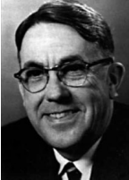
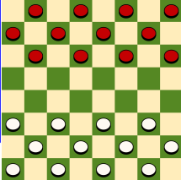
What is machine learning?
Arthur Samuel (1959): Machine Learning is the field of study that gives the computer the ability to learn without being explicitly programmed.

Slide 8

What is machine learning?
Tom Mitchell (1998): a computer program is said to learn from experience E with respect to some class of tasks T and performance measure P, if its performance at tasks in T, as measured by P, improves with experience E.
Experience (data): games played by the program (with itself) Performance measure: winning rate

Slide 9




What is machine learning? Using Data to Train Machines
“A computer program is said to learn from experience E with respect to some
class of tasks T and performance measure P
if its performance at tasks in T, as measured by P, improves with experience E.”
(Tom Mitchell, 1997)
Tasks
Experience (Training Data)
Training
Learning algorithm
Prediction
Performance measure
Goal
Result

Slide 10
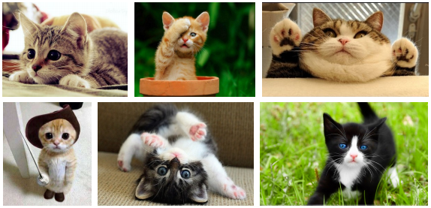
What is Machine Learning?
How can we solve a specific problem?
As computer scientists you write a program that encodes a set of rules that are useful to solve the problem
In many cases it is very difficult to specify those rules, e.g., given a picture determine whether there is a cat in the image
Learning systems are not directly programmed to solve a problem, instead they develop own program based on:
Examples of how they should behave
From trial-and-error experience trying to solve the problem
Learning simply means incorporating information from the training examples into the system

Slide 11
Why use learning?
It is very hard to write programs that solve problems like recognizing a handwritten digit
What distinguishes a 2 from a 7?
How does our brain do it?
Instead of writing a program by hand, we collect examples that specify the correct output for a given input
A machine learning algorithm then takes these examples and produces a program that does the job
The program produced by the learning algorithm may look very different from a typical hand-written program.
If we do it right, the program works for new cases as well as the ones we trained it on

Slide 12
When to use learning
There is no need to “learn” to calculate payroll or other simple calculations
Learning is used when:
No human experts
industrial/manufacturing control
mass spectrometer analysis, drug design, astronomic discovery, navigating on Mars
Black-box human expertise
face/handwriting/speech recognition
driving a car, flying a plane
Rapidly changing phenomena
credit scoring, financial modeling
diagnosis, fraud detection
routing on a computer
Need for customization/personalization
personalized news reader
movie/book recommendation
user biometrics

Slide 13
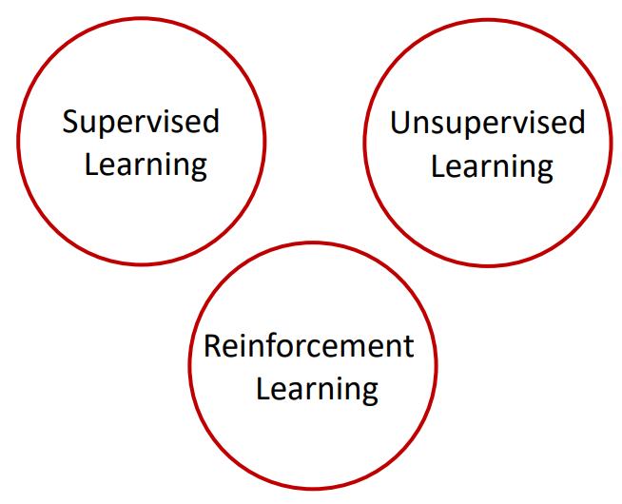
Taxonomy of Machine Learning (A Simplistic View Based on Tasks)

Slide 14




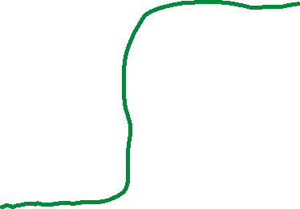













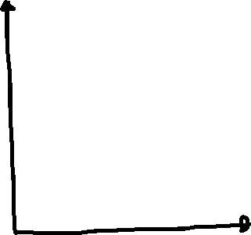




Supervised

Slide 15











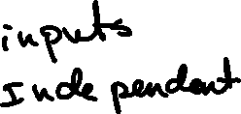


Slide 16


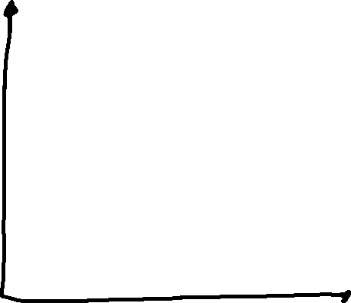
Supervised

Slide 17

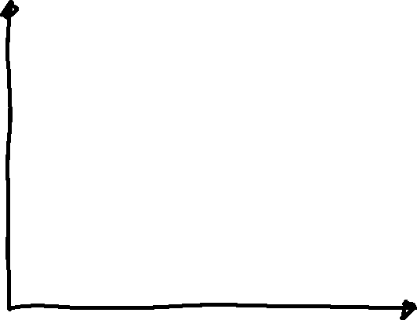


Unsupervised

Slide 18
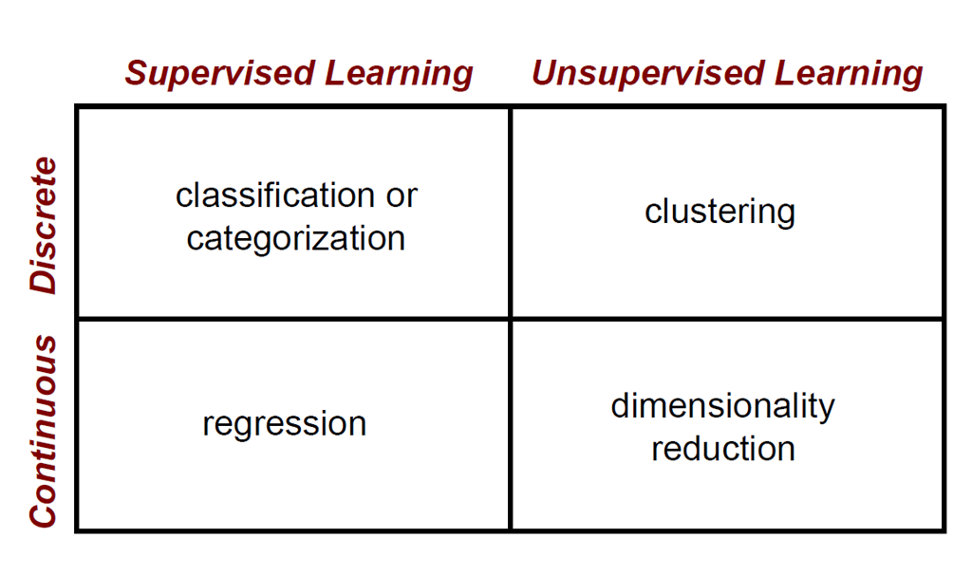
Machine Learning Problems

Slide 19
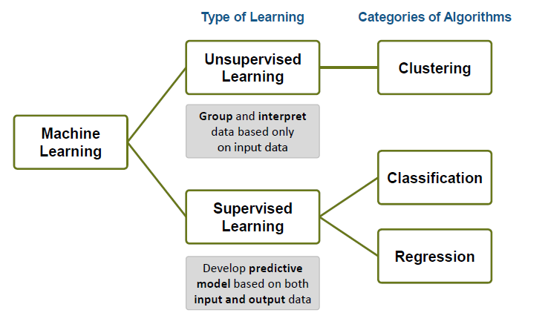
Machine Learning – An Overview

Slide 20
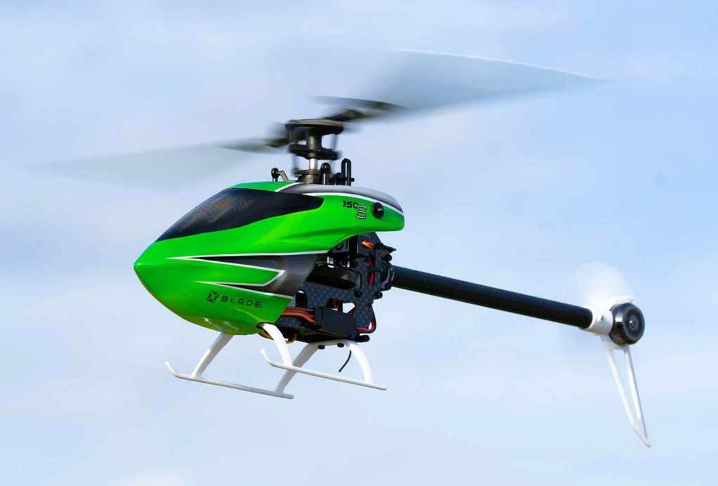
Reinforcement Learning

Slide 21

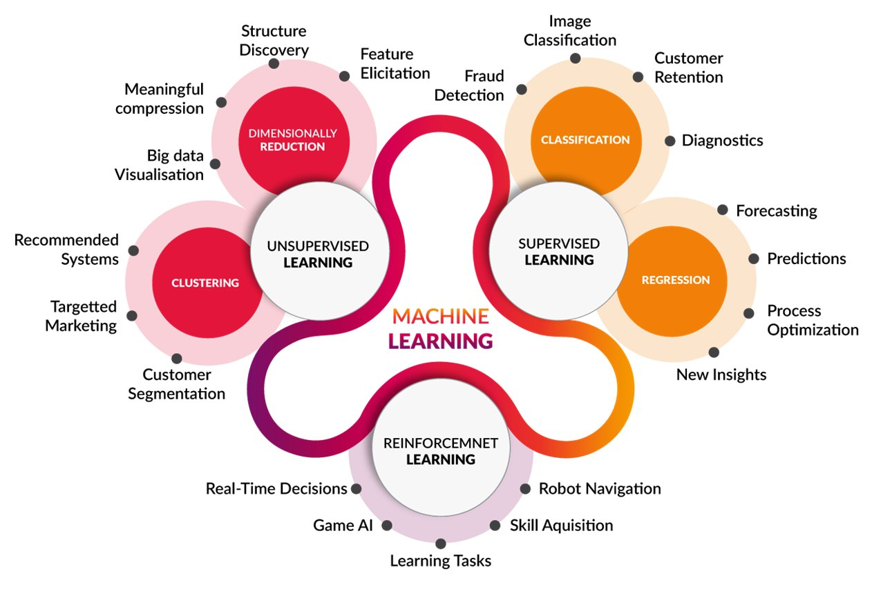
There are many types of machine learning!
Image source: http://www.cognub.com/index.php/cognitive-platform/

Slide 22
Machine learning methodology
Data
Machine learning algorithm
Training data
Trained
model
Features
Labels
Labels
New data
Predicted
label
Only features!

Slide 23


















Näive Bayes

Slide 24
































Slide 25
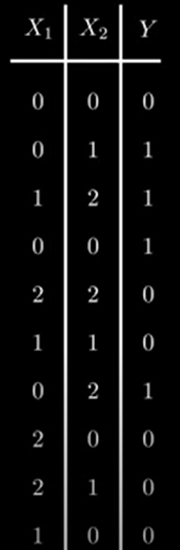




































Slide 26



















Slide 27
























Slide 28



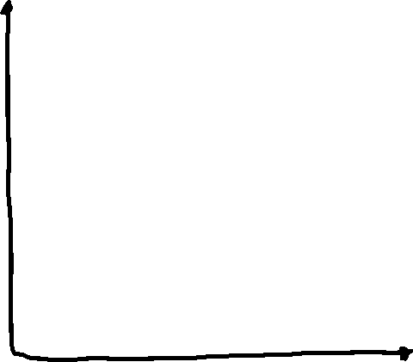







Slide 29
Value of K
Choosing the value of k:
If k is too small, sensitive to noise points
If k is too large, neighborhood may include points from other classes
Rule of thumb:
K = sqrt(N)
N: number of training points

Slide 30
Definition of Nearest Neighbor
K-nearest neighbors of a record x are data points that have the k smallest distance to x

Slide 31
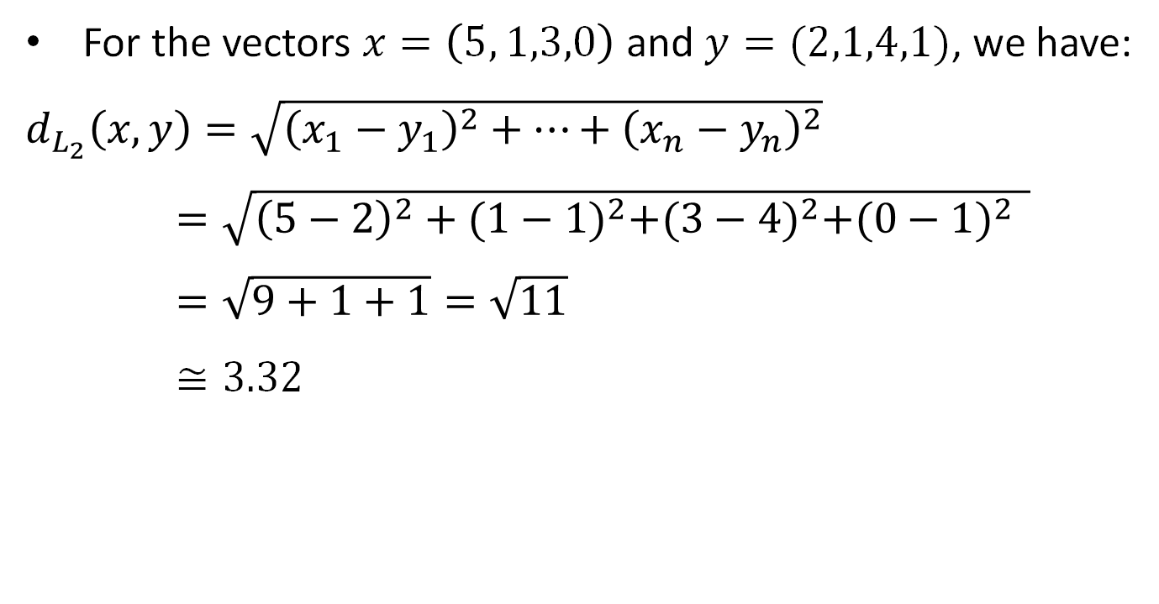

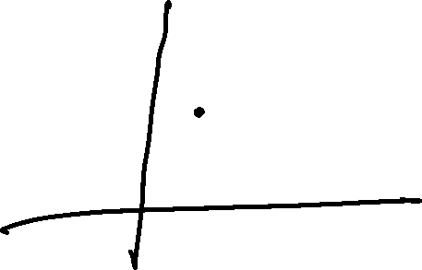
The Euclidean distance (L₂)
For the vectors $x=\left(5, 1,3,0\right)$ and $y=(2,1,4,1)$, we have:
$d_{L_{2}}\left(x,y\right)=\sqrt{{\left(x_{1}−y_{1}\right)}^{2}+…+{\left(x_{n}−y_{n}\right)}^{2}}$
$=\sqrt{{\left(5−2\right)}^{2}+{(1−1)}^{2}+{(3−4)}^{2}+{(0−1)}^{2 } }$
$=\sqrt{9+1+1}=\sqrt{11}$
$≅3.32$

Slide 32
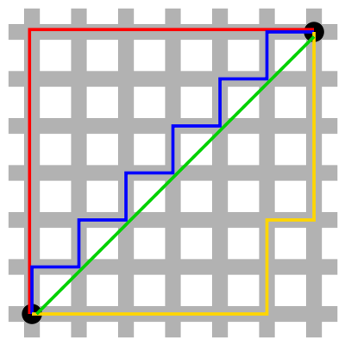
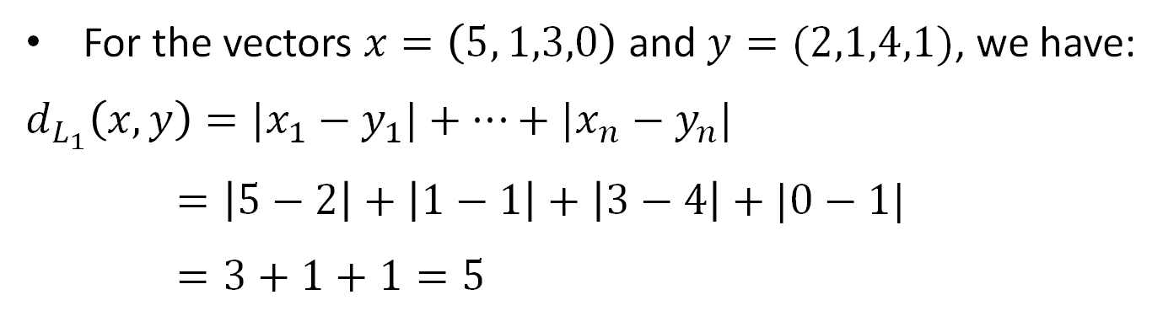
The Manhattan distance (L₁)
For the vectors $x=\left(5, 1,3,0\right)$ and $y=(2,1,4,1)$, we have:
$d_{L_{1}}\left(x,y\right)={|x}_{1}−y_{1}|+…+{|x}_{n}−y_{n}|$
$=\left|5−2\right|+\left|1−1\right|+\left|3−4\right|+|0−1|$
$=3+1+1=5$

Slide 33
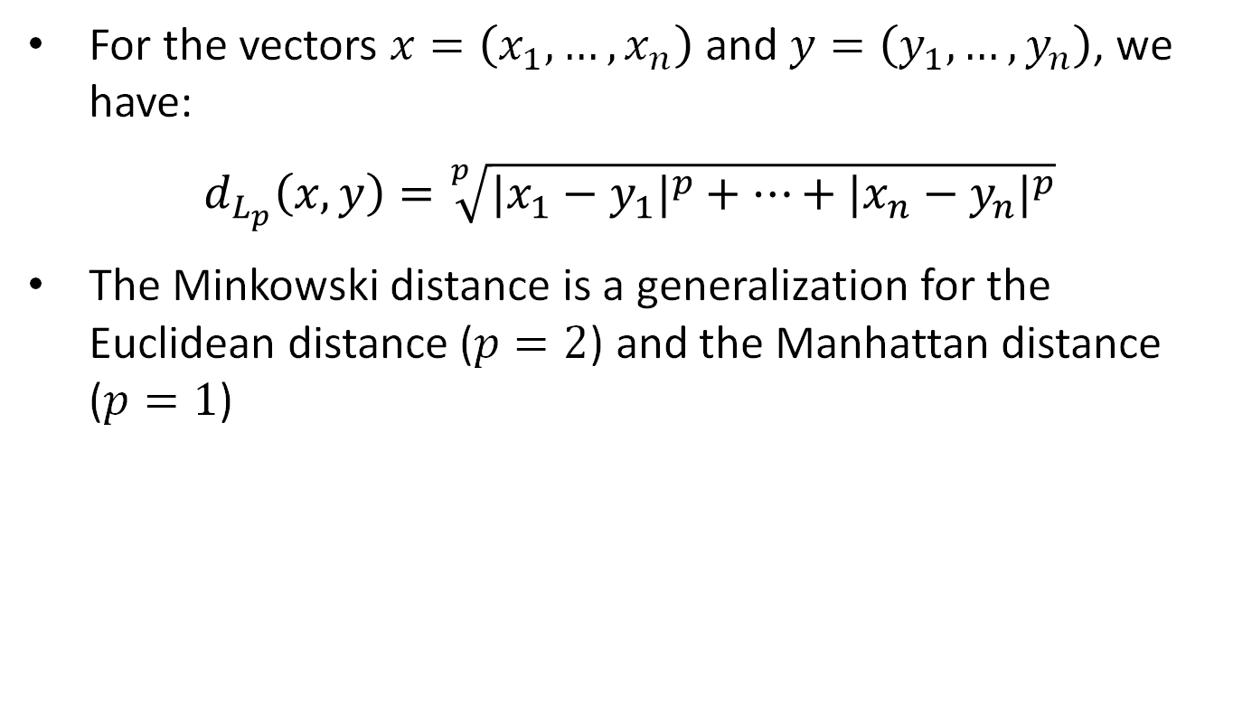
The Minkowski distance (L_{p})
For the vectors $x=\left(x_{1}, …,x_{n}\right)$ and $y=\left(y_{1},…,y_{n}\right)$, we have:
$d_{L_{p}}\left(x,y\right)=\sqrt[p]{{{|x}_{1}−y_{1}|}^{p}+…+{{|x}_{n}−y_{n}|}^{p}}$
The Minkowski distance is a generalization for the Euclidean distance ($p=2$) and the Manhattan distance ($p=1$)

Slide 34
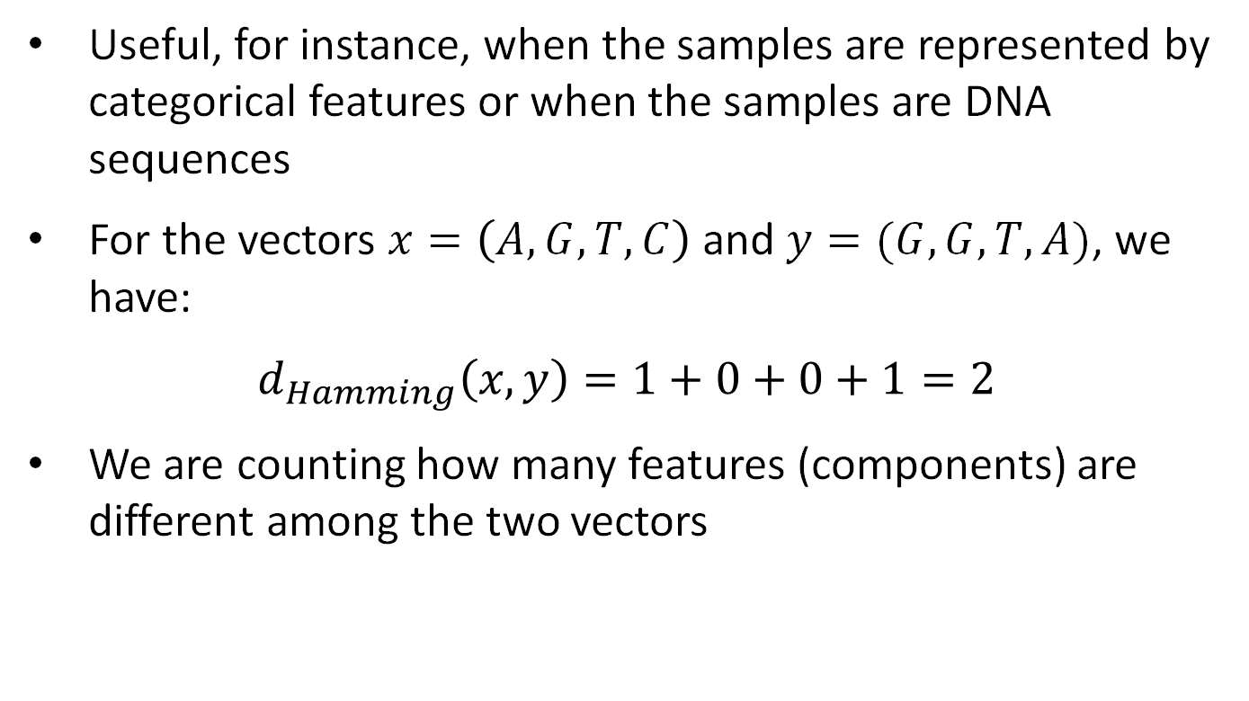
The Hamming distance
Useful, for instance, when the samples are represented by categorical features or when the samples are DNA sequences
For the vectors $x=\left(A, G,T,C\right)$ and $y=(G,G,T,A)$, we have:
$d_{Hamming}\left(x,y\right)=1+0+0+1=2$
We are counting how many features (components) are different among the two vectors

Slide 35
The Edit (Levenstein) distance
Useful, for instance, when the samples are strings (text documents, DNA sequences) or temporal sequences (videos)
The distance is given by the number of changes (insert, delete, replace) necessary to transform one object into the other
For video sequences, we use Dynamic Time Warping (DTW)

Slide 36
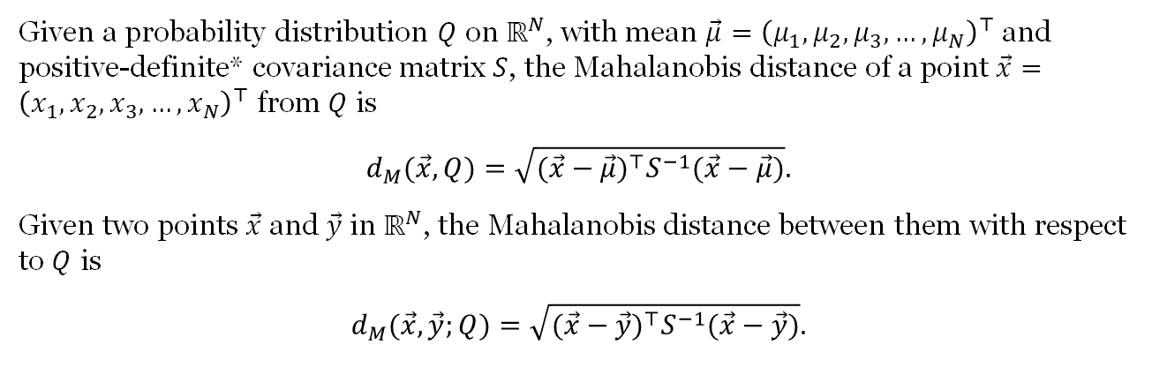
Mahalanobis
Given a probability distribution $Q$ on $ℝ^{N}$, with mean $\vec{μ}={\left(μ_{1},μ_{2},μ_{3},…,μ_{N}\right)}^{⊤}$ and positive-definite* covariance matrix $S$, the Mahalanobis distance of a point $\vec{x}={\left(x_{1},x_{2},x_{3},…,x_{N}\right)}^{⊤}$ from $Q$ is
$$d_{M}(\vec{x},Q)=\sqrt{(\vec{x}−\vec{μ})^{⊤}S^{−1}(\vec{x}−\vec{μ})}.$$
Given two points $\vec{x}$ and $\vec{y}$ in $ℝ^{N}$, the Mahalanobis distance between them with respect to $Q$ is
$$d_{M}(\vec{x},\vec{y};Q)=\sqrt{(\vec{x}−\vec{y})^{⊤}S^{−1}(\vec{x}−\vec{y})}.$$
* a symmetric matrix whose every eigenvalue is positive.

Slide 37
Distance Measure: Scale Effects
Different features may have different measurement scales
E.g., patient weight in kg (range [50,200]) vs. blood protein values in ng/dL (range [-3,3])
Consequences
Patient weight will have a much greater influence on the distance between samples
May bias the performance of the classifier

Slide 38

















Train Test

Slide 39
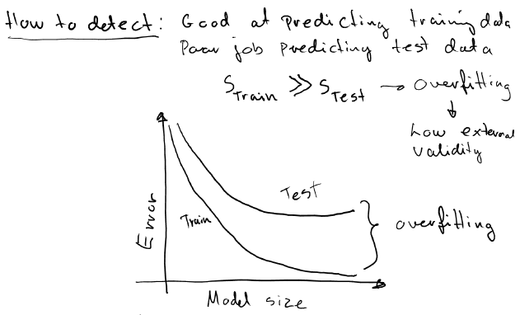


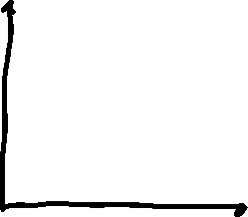



Slide 40
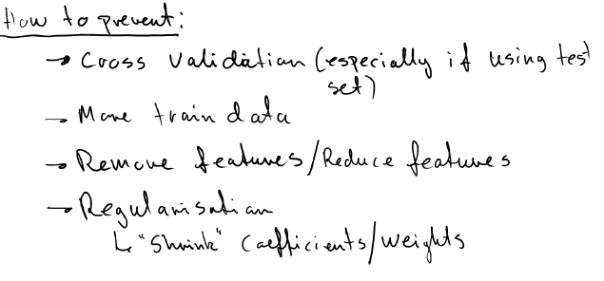

Slide 41
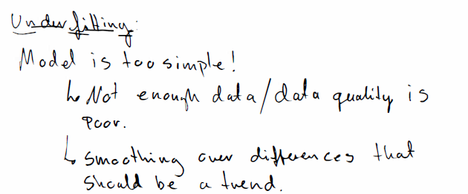


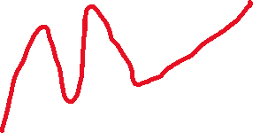

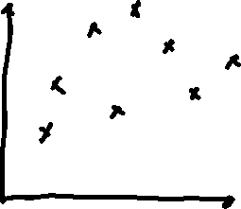



Slide 42
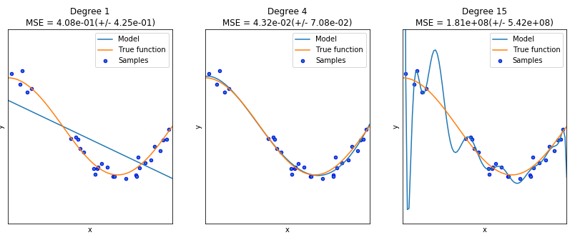
Overfitting and underfitting

Slide 43
Test accuracy
Tune hyperparameters
Data
Machine learning algorithm
Training data
Trained
model
Features
Labels
Labels
Testing data
New data
Predicted
label
Only features!

